Slide 1
Digital Design Assignment Report
BY GROUP 68
2019AAPS0230G: Rahul Peter
2019AAPS0235G: Agrawal Krishi
2019AAPS0242G: Neelareddy Siddartha
2019AAPS0247G: Sarthak Chakrabarti
2019AAPS0250G: Sayan Dutta Pramanik
2019AAPS0257G: Sarweshwar Mohapatro

Slide 2
Problem Statement
Design a traffic signal system at a junction of 2 roads, a highway and a side street. The signal system should be in designed in such a way so as to not impede traffic on the highway. The signal must switch only when a car shows up on the side street.

Slide 3
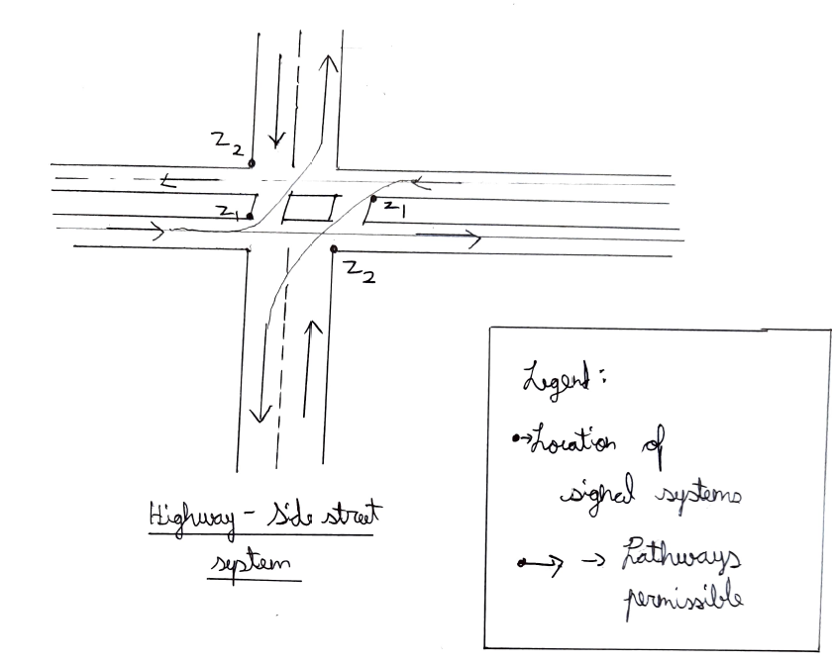
Diagram of the system
This is the basic idea of our designing. One of them is the side street and the other highway.

Slide 4
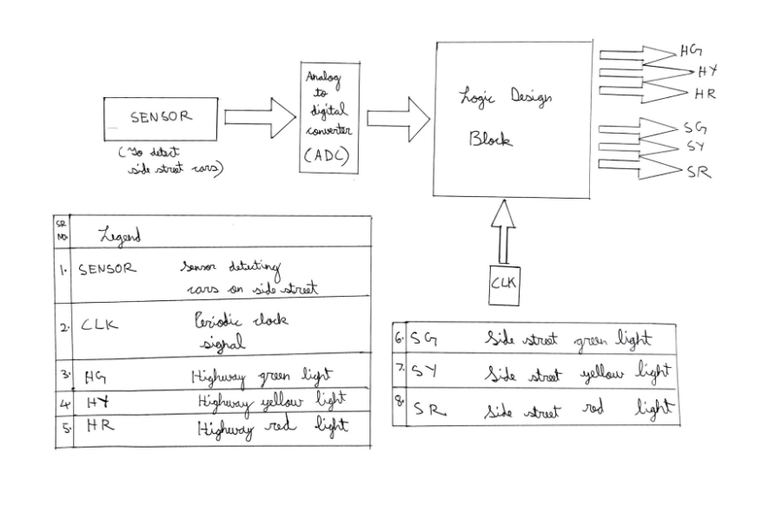
Top level Block Diagram
Input is the sensor which is dependent on the current state of car on side street.
Outputs are the 6 different signal systems distributed equally among the side street and the highway street.

Slide 5
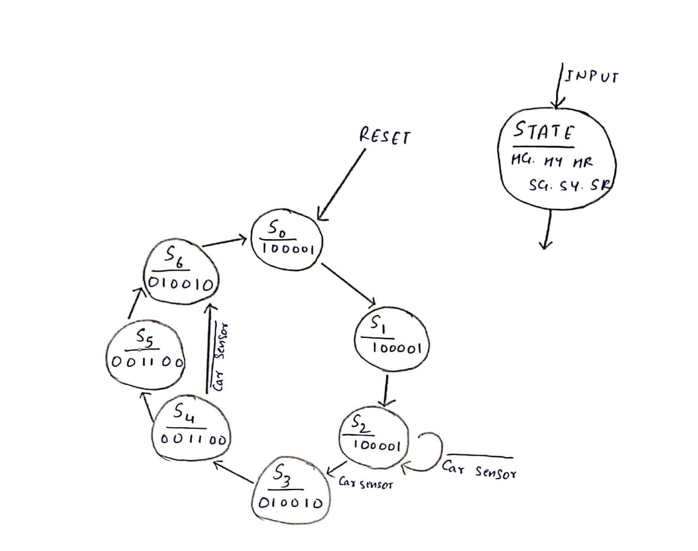
State Diagram
There are 7 states in our design which gives 6 outputs.
Each and every 1 stands for ON and 0 for OFF.
The system is based on the signal received from the sensor.

Slide 6
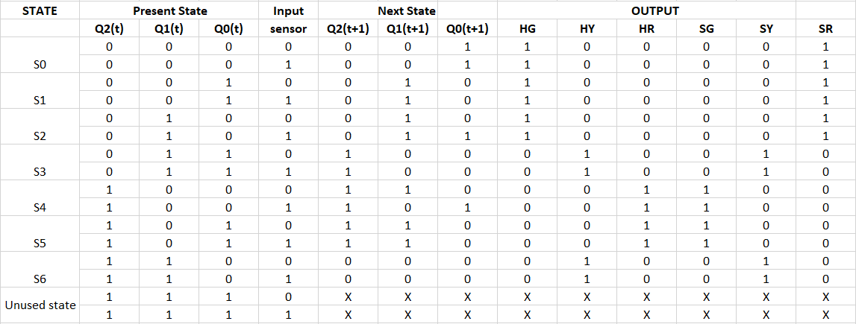
State Table

Slide 7
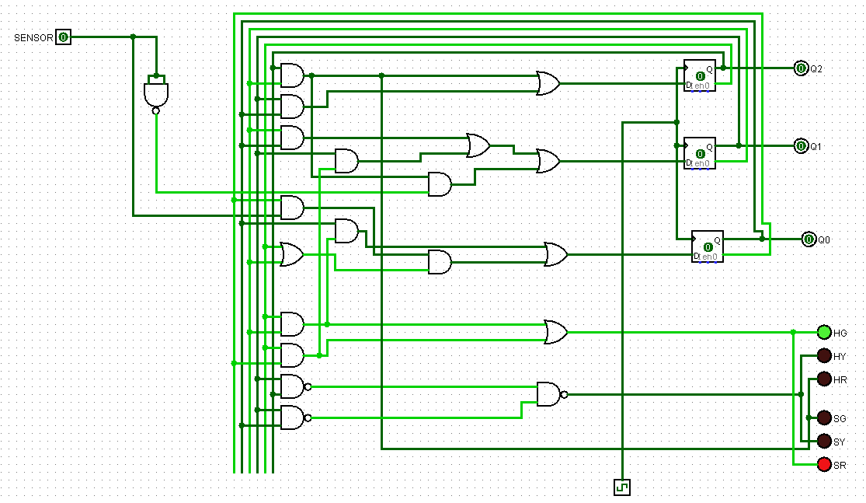
Our solution
The SENSOR is the input to the circuit.
There are 3 D flip flops used.
6 different lights are used as the output to the system.

Slide 8
Additional functionality
When a vehicle is detected on the side street, the signal system is activated, and the traffic lights facing the highway cycle from green to red via yellow, and then back to green via yellow again, after which point the system is reset and waits until another vehicle is detected on the side street. The same holds true for the side street traffic lights. This is to ensure
smooth traffic movement.

Slide 9
Our working of the system is simulated in LOGISIM
Sample input/ouput combination is also simulated in Logisim only.

